Slide 1
Assignment-1 Student information
Submitted By
Priyabrota sen (papon)
Date: 20-05-2017

Slide 2
Student Information Management
Create student information
Edit student information
Delete student information
Show student information
Client Side validation
Server side validation

Slide 3
Project Requirements
Grails 3.3.0
Groovy
Java 1.8.0
MySQL 5.1
Bootstrap 3.3.6 CSS
Bootstrap 3.3.6 JS

Slide 4

Home page

Slide 5
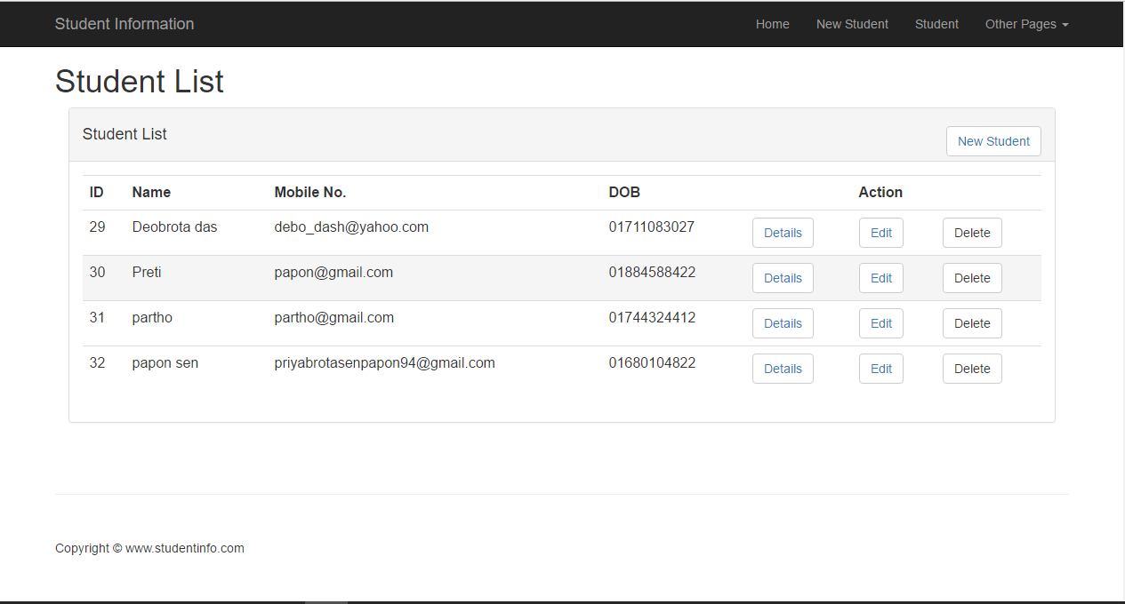
Student information main page

Slide 6
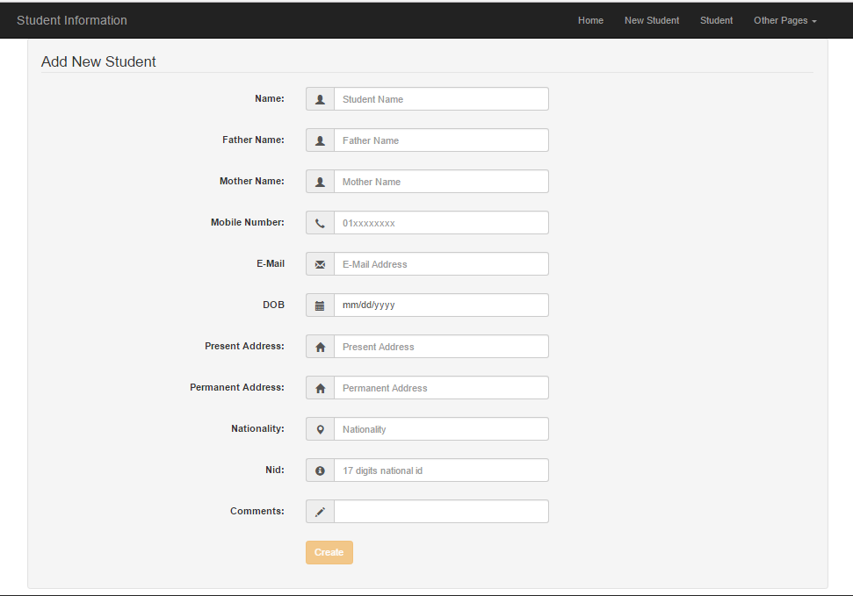
Student information create page

Slide 7
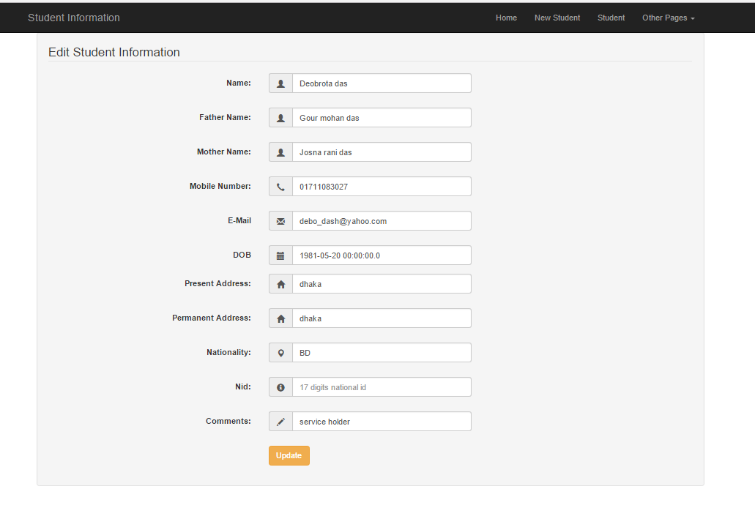
Student information edit page

Slide 8
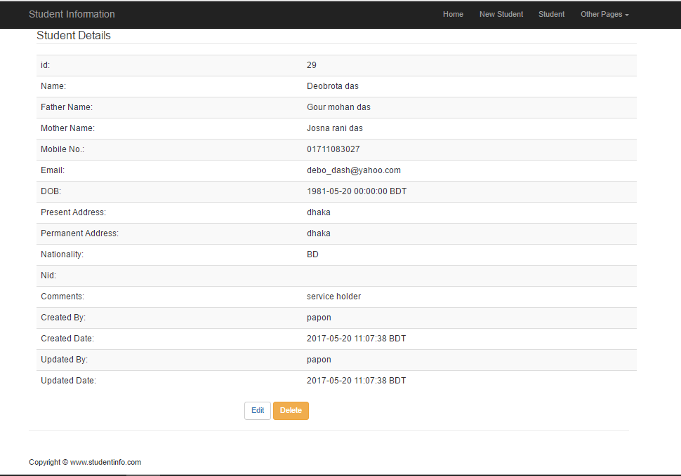
Student information Details page

Slide 9
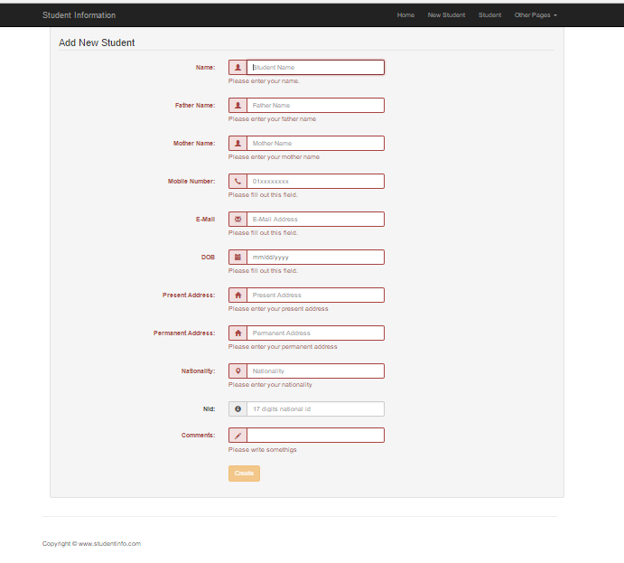
Client side validation

Slide 10
References
Getting Started with Grails Second Edition
by Scott Davis and Jason Rudolph
Bootstrap 3 Tutorial
-- https://www.w3schools.com/bootstrap/default.asp

